Slide 1
CIRCUIT AND SYSTEMS
COURSE CODE: ETEE-207
By
Mr. LALIT AGARWAL
ASSISTANT PROFESSOR
EEE, MAIT

Slide 2
LECTURE-1

Slide 3
SYLLABUS
UNIT-I
Introduction to signals, their classification and properties, different types of systems, LTI systems and their properties, periodic waveforms and signal synthesis, properties and applications of Laplace transform of complex waveform.
UNIT-II
System modeling in terms of differential equations and transient response of R, L, C, series and parallel circuits for impulse, step, ramp, sinusoidal and exponential signals by classical method and using Laplace transform.
Contd……

Slide 4
UNIT-III
Graph theory: concept of tree, tie set matrix, cut set matrix and application to solve electric networks.
Two port networks – Introduction of two port parameters and their inter-conversion, interconnection of two 2-port networks, open circuit and short circuit impedances and ABCD constants, relation between image impedances and short circuit and open circuit impedances. Network functions, their properties and concept of transform impedance, Hurwitz polynomial.
UNIT IV
Positive real function and synthesis of LC, RC, RL Networks in Foster’s I and II, Cauer’s I& II forms, Introduction of passive filter and their classification, frequency response, characteristic impedance of low pass, high pass, Band Pass and Band reject prototype section.

Slide 5
OBJECTIVE
The purpose of this course is for each student to learn and further explore the techniques of advanced circuit analysis. The concepts and analytical techniques gained in this course (e.g., signals, Laplace transformation, frequency response) will enable students to build an essential foundation of many fields within electrical engineering, such as control theory, analog electronic circuits, signal processing.

Slide 6
TEXT BOOKS
[T1] W H Hayt “Engineering Circuit Analysis” TMH Eighth Edition
[T2] Kuo, “Network analysis and synthesis” John Weily and Sons, 2nd Edition.
REFERENCE BOOKS
[R1] S Salivahanan “Circuit Theory ” Vikas Publishing House 1st Edition 2014
[R2] Van Valkenburg, “ Network analysis” PHI, 2000.
[R3] Bhise, Chadda, Kulshreshtha, “ Engineering network analysis and filter design” Umesh publication, 2000.
[R4] D. R. Choudhary, “Networks and Systems” New Age International, 1999
[R5] Allan H Robbins, W.C.Miller “Circuit Analysis theory and Practice”Cengage Learning Pub 5th Edition 2013
[R6] Bell “Electric Circuit” Oxford Publications 7th Edition.

Slide 7
LECTURE PLAN
S.No. | TOPICS TO BE COVERED | Total No. of Lectures
UNIT-I | (Signals & Systems)
1 | Introduction of the subject, role and importance of Circuits in Engineering. | 1
2 | Introduction to signals: Continuous-time & Discrete-time Periodic & a periodic, Power & Energy Signals. | 1
3 | Impulse, Step, Ramp Signals & Signal Synthesis using these waveforms, introducing the properties of Time-shifting, Magnitude Scaling, etc. | 1
4 | Systems classification, LTI Systems & their properties | 2
5 | Introduction to Laplace Transform, Inverse Transform & their properties | 2
6 | Periodic Waveforms: Synthesis and Laplace Transform for Periodic & other complex waveforms. | 2

Slide 8
S.No. | TOPICS TO BE COVERED | Total No. of Lectures
UNIT-II | (Transient Analysis)
7 | Dynamic Circuits having Inductors & Capacitors governed by First order and Second order Differential Equations. | 2
8 | Basic properties exhibited by Time-Invariant Capacitors & Inductors : Memory, Continuity, Lossless Properties | 2
9 | First-order Differential Equation, Second order Differential Equation and their solution by Classical Method | 2
10 | Classical method of solution: Transient Analysis of Circuits with R, L, C. | 2
11 | Transient Response of Series & Parallel R-L, R-C & R-L-C Circuits for D.C. Excitations (using Laplace Transform) | 2
12 | Transient Response of Circuits by Laplace – Transformed Circuit approach to impulse, step, ramp, sinusoidal & exponential signals | 2

Slide 9
S.No. | TOPICS TO BE COVERED | Total No. of Lectures
UNIT-III | ( Graph Theory &Two-Port Networks) | 1
13 | Concept of tree, twig, links, Incidence matrix | 2
14 | tie set matrix, cut set matrix and application to solve electric networks | 2
15 | Introduction of Two-Port Networks, Various parameters and their inter-conversion | 2
16 | Inter-connections of two port networks | 2
17 | Open-circuit & short circuit Impedances, Image Impedances and their inter-relation | 2

Slide 10
S.No. | TOPICS TO BE COVERED | Total No. of Lectures
UNIT-IV | (Network Synthesis and Passive Filters) | 2
18 | Network Functions, their properties and concept of Transform Impedances | 2
19 | Network Synthesis : Hurwitz Polynomial and Properties | 2
20 | Positive Real Functions & Properties, Testing a function to be p.r.f. | 2
21 | Synthesis of One-port Networks with two kinds of elements : LC, RC & RL in Foster’s-I & II Form and in Cauer’s I & II Form | 2
22 | Introduction of Passive Filters, their properties & classification as LPF, HPF, BPF & Band Reject Filters | 2
23 | Frequency Response & Characteristic Impedance of the LPF, HPF, BPF & Band Reject prototype section | 2

Slide 11
INTRODUCTION
What is Network?
What is Circuit?
What is the difference between network and circuit? Are they both same?
What are the circuit elements?
Electrical energy sources

Slide 12
An electric network is nothing but any possible interconnection of electric circuit elements…..whether this connection is a closed one or open one or of any shape.
But an electric circuit is a closed energized network.
All the circuits are networks while all the networks are not necessarily circuits.
e.g. T-network

Slide 13
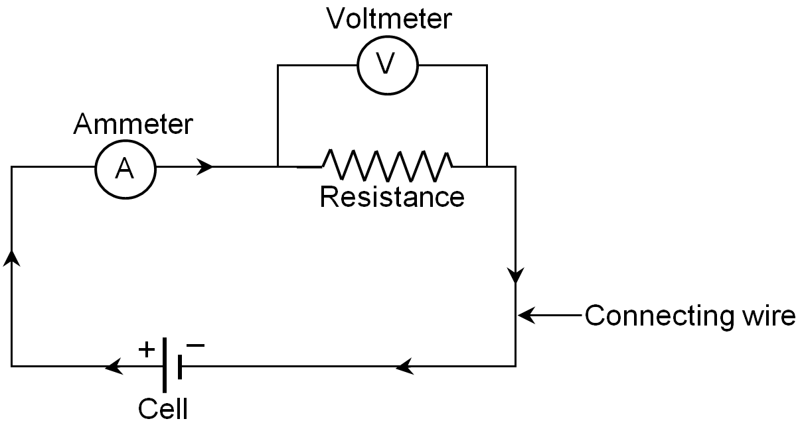
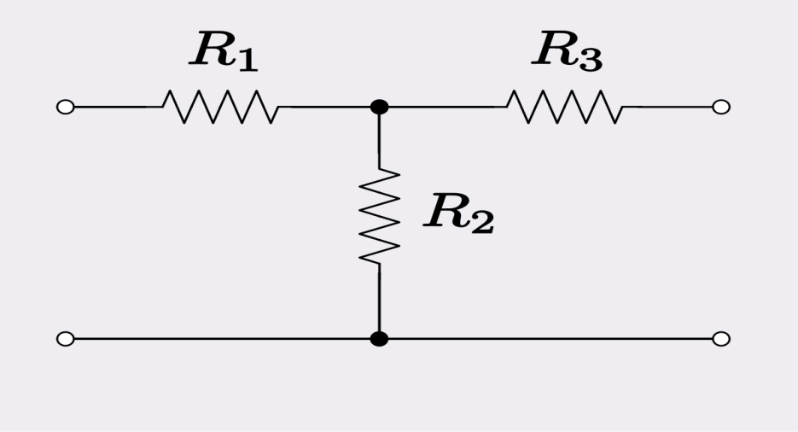
A simple electrical circuit is shown below
A simple T-network is shown below

Slide 14
Circuit Elements
They may be characterized as
Unilateral or Bilateral
Linear or Non-linear
Active or Passive
Lumped or distributive

Slide 15
Unilateral & Bilateral Elements
Unilateral Elements have different relationship between voltage and current for two possible directions of current.
e.g. Diodes, metal rectifiers etc.
Whereas Bilateral elements have same relationship between voltage and current for two possible directions of current.
e.g. Resistor, Inductor & Capacitor, Diac, Triac

Slide 16
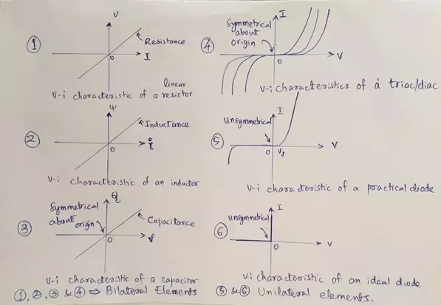

Slide 17
Linear & Non-linear Elements
Linear elements have linear relationship between voltage and current.
e.g. Resistor, Inductor, Capacitor, Transformer
Whereas non linear elements don’t have a linear input/output relationship.
e.g. Diode, Transistor etc

Slide 18
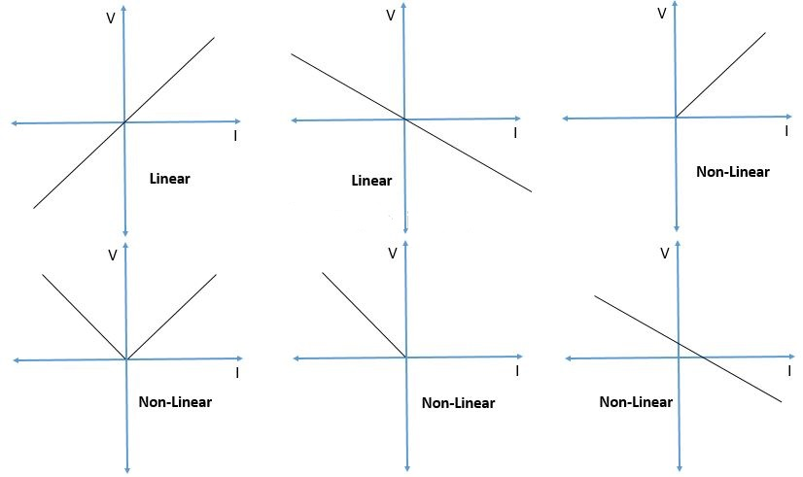

Slide 19
Active & Passive Elements
The elements which can generate or produce electrical energy are termed as active elements.
e.g. Batteries, generators, voltage and current sources etc
V-I graph of the active element has a -ve slope and lies in the 2nd / 4th quadrant.
The elements which consume the electrical energy rather generating it , are termed as passive elements.
e.g. Resistors, inductors, capacitors
V-I graph of the passive element has a +ve slope and lies in the 1st /3rd quadrant.

Slide 20
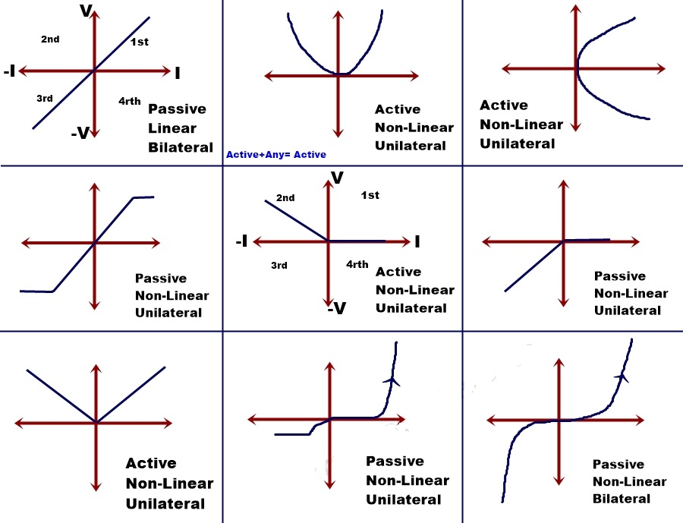

Slide 21
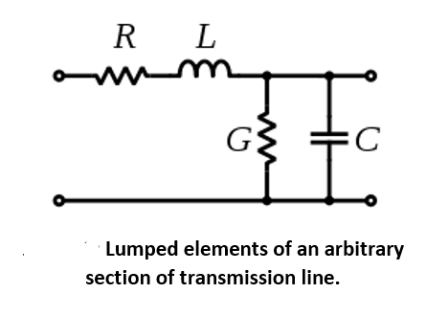
Lumped & Distributed Elements
A lumped element is the one which can be separated physically.
e.g. Resistor, Capacitor, Inductor
The distributed elements are those which can’t be separated for analytical purpose.
e.g. Transmission lines

Slide 22
ELECTRICAL ENERGY SOURCES
ELECTRICAL ENERGY SOURCES
VOLTAGE SOURCE(V)
DEPENDENT
INDEPENDENT
CURRENT SOURCE(I)
DEPENDENT
INDEPENDENT

Slide 23
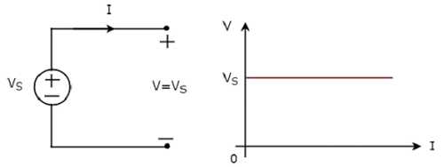
Independent Voltage & current sources are further of two types:
Ideal
Practical
Ideal voltage source maintains a constant terminal voltage irrespective of the value of the current through it’s terminals.

Slide 24
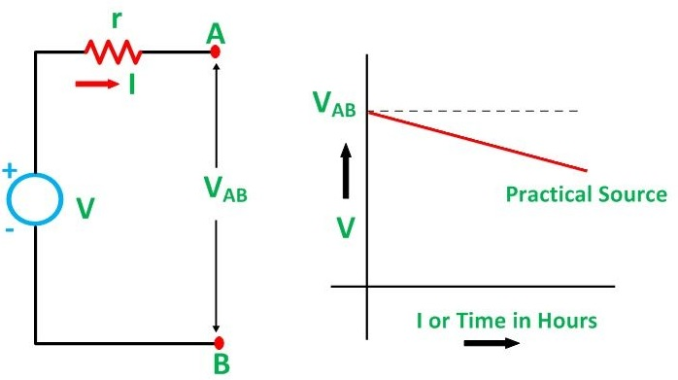
In the practical voltage source the voltage across the terminals of the source keeps falling as the current through it increases.

Slide 25
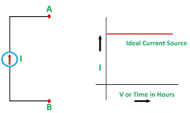
Ideal current source maintains a constant current irrespective of the value of terminal voltage.

Slide 26
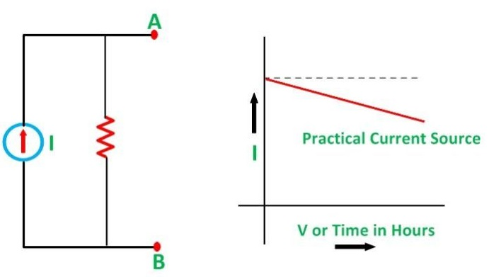
In the practical current source the current through the terminals of the source keeps falling as the terminal voltage across it increases.

Slide 27
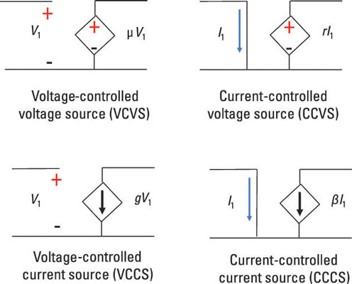
Dependent or Controlled sources
There are of four types.
Voltage controlled voltage source (VCVS)
Voltage controlled current source (VCCS)
Current controlled voltage source (CCVS)
Current controlled current source (CCCS)

